Slide 1
Coevolution of Supermassive Black Holes and Their Host Galaxies
Josie Schindler
Northern Arizona University
Dr. R Scott Barrows, University of Colorado at Boulder
Notes:
Whatever process has contributed to the buildup of the SMBH mass has also contributed to the shapping of the morphology of the hos galaxy.
Density wave theory

Slide 2
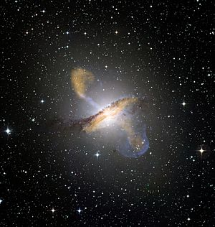
AGN 101
Active Galactic Nuclei (AGN)– what are they?
How does material get to the black hole?
Image: Centaurus A
Credit: European Southern Observatory
Notes:
What is an Active Galactic Nucleus? Well, we predict that most galaxies have a supermassive black hole located in the centers. These black holes are still growing, ie, they are still accreting matter. We find these often occur during mergers of galaxies, but sometimes we find galaxies with no outside interactions will often have these active nuclei. AGN will appear much brighter than the nuclei of quiescent galaxies, or where the nucleus is not growing. In this example, we see the nucleus is actually ejecting material into space.
Bullet 2
For quiescent galaxies, material – stars, gas, etc, has enough velocity, enough kinetic energy to maintain a stable orbit so that it does not fall in. There is some mechanism that causes the material to lose that kinetic energy, to fall into the blackhole, making it active. That mechanism is what we are trying to find out.
------Powered by accretion onto a supermassive black hole at the center f theglaaxy
How does material get down to the block hole in order to power it? This is what we are trying to find.
---evidence for the supermassive black hole affect the evolution of its host gaaxy
(centaurus A – radio jets)

Slide 3
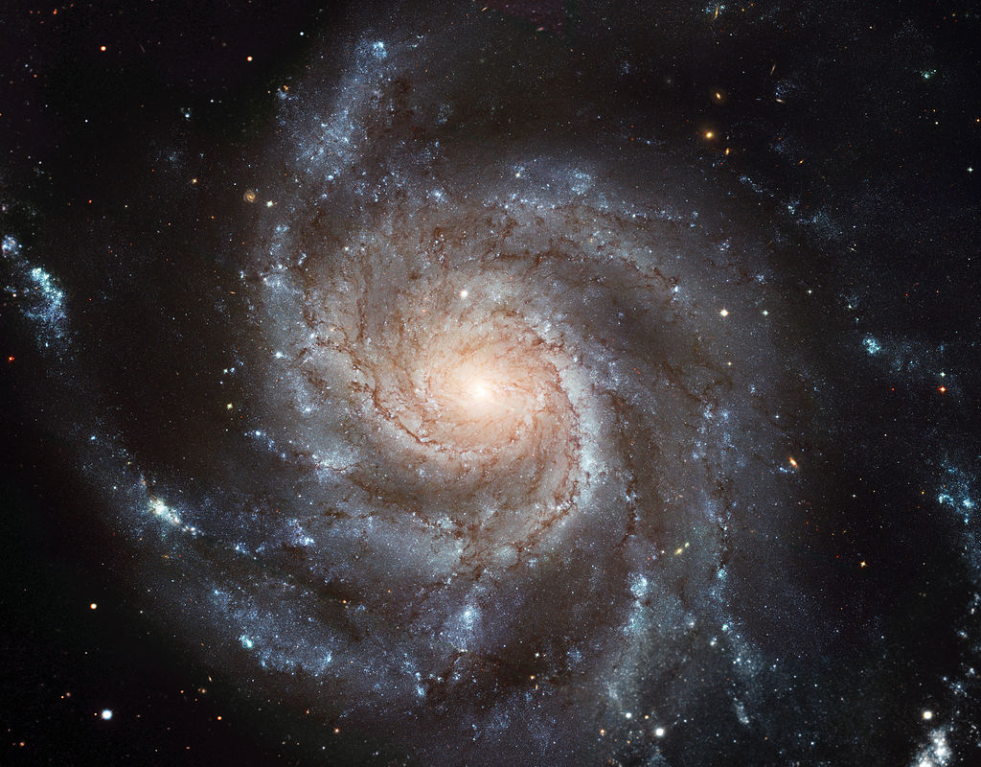
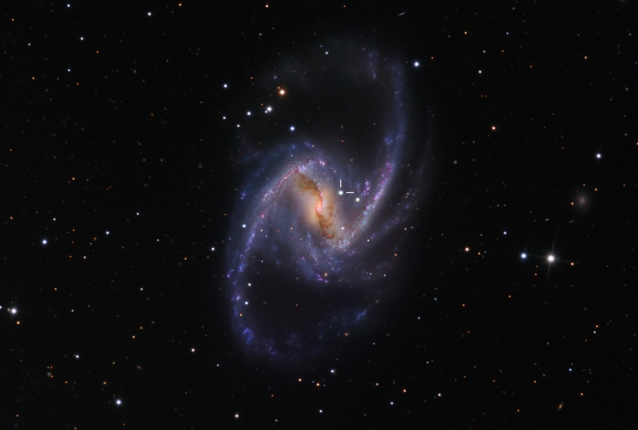
Spiral Galaxies
Image: M101 Pinwheel Galaxy, Ursa Major
Credit: Hubble Space Telescope
Image: NGC1365, Fornax
Credit: Martin Pugh
Notes:
Here we have some examples of spiral galaxies, the Pinwheel Galaxy on the left, and NGC1365 on the right. Spiral galaxies are the most common type of galaxy found in space. In my project, I was specifically looking at spiral galaxies with AGN. Since these galaxies have a distinct order to them, they are unlikely to have undergone a merger. Whatever causes the nucleus to be active would have to be internal. My job was to determine if there is a correlation between pitch angle, or how tightly wound the spiral arms are, and the mass of the black hole. We predicted that a larger black hole mass would beget tighter spiral arms. The left galaxy is an example of smaller pitch angle, and the right has larger pitch angle.
----------We see AGN in spirals so there ust be some sort of fueling mechanism that’s casuing this.
The purpose of this project is to see how the rowth of the smbh is corrated with any properties of the host spiral

Slide 4
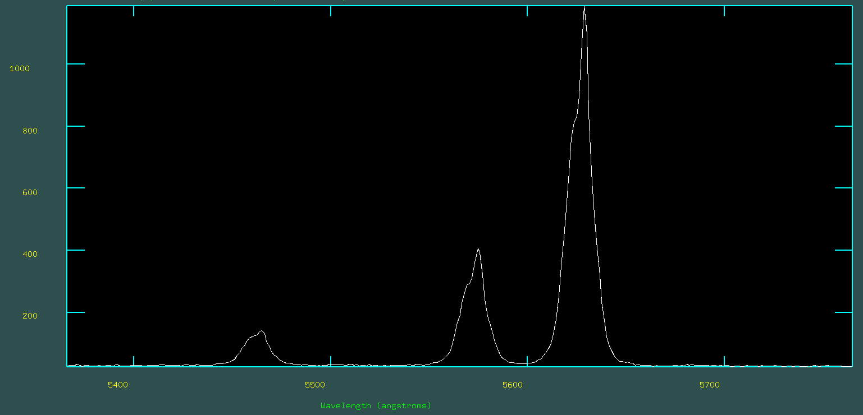
Finding Black Hole Mass
Finding AGN and calculating Black Hole Mass
[OIII]
Flux (${10}^{−17}ergs s^{−1}{cm}^{2}$)
H-$β$
Wavelength (Å$)$
Notes:
Ok, to find spiral galaxies with AGN, I had to find galaxies whose emissions line met certain criteria. Here are some examples of emissions lines that I was particularly interested in. An AGN would have emissions lines in OIII, H Beta, NII, H Alpha and SII. What these are, are excitation states of electrons in these specific elements, Hydrogen, Oxygen, Nitrogen and Sulphur. These are considered forbidden transitions because we do not find these naturally here on Earth.

Slide 5
Finding AGN and calculating Black Hole Mass
[NII]
H-$α$
Flux (${10}^{−17}ergs s^{−1}{cm}^{2}$)
[SII]
Wavelength (Å$)$

Slide 6
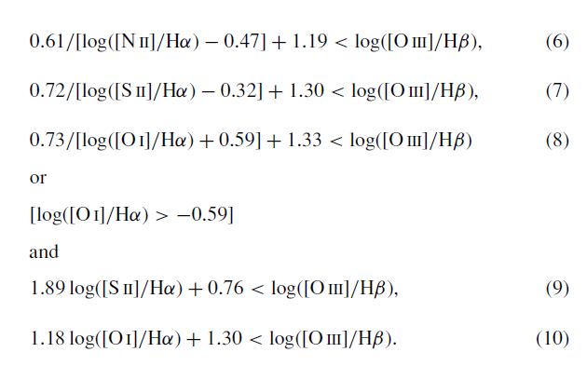
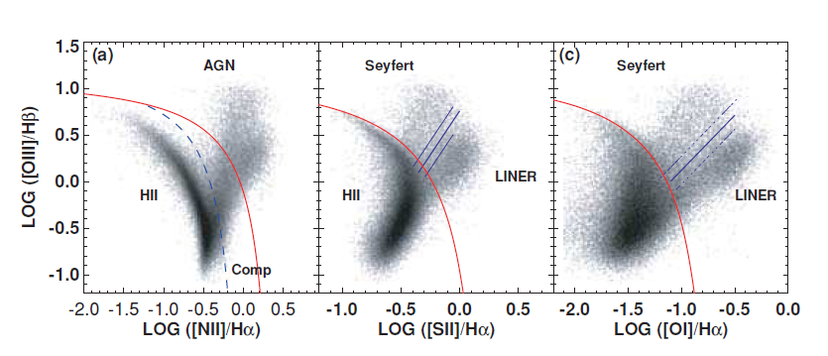
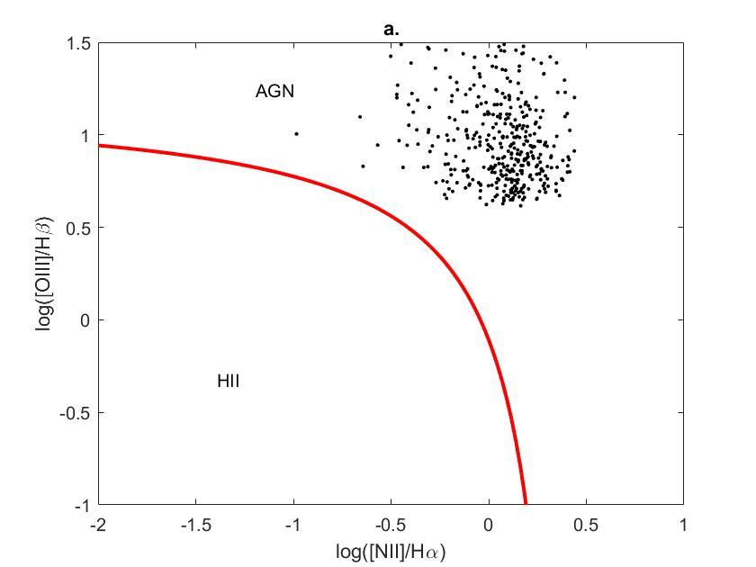
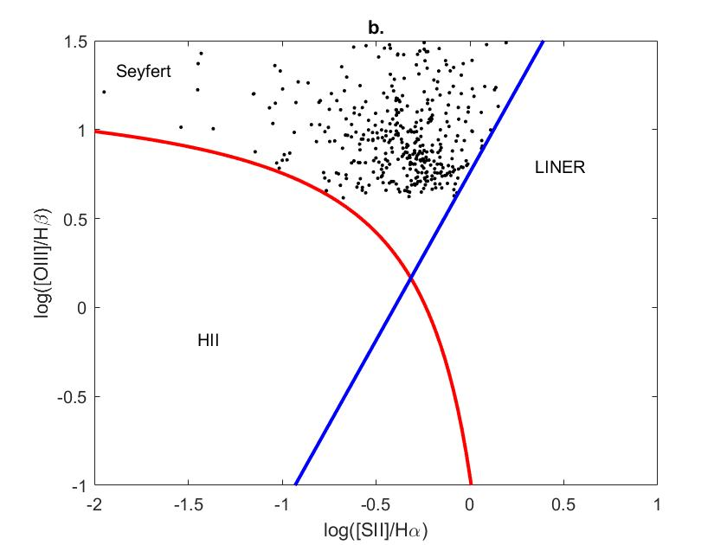
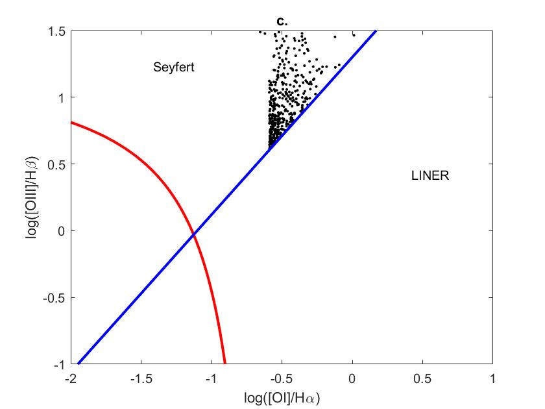
Finding Spiral AGN
“The host galaxies and classification of active galactic nuclei”
– Lisa J. Kewley, 2006
Notes:
As it turns out the emissions lines would have to satisfy certain criteria in order to be an AGN. This was fortunately spelled out for me already, I just had to obtain my sample. The plots on the left are from Lisa Kewley’s 2006 paper. It compares the ratios of the transitions for oxygen, sulpher and nitrogen with the balmer lines. Any thing that falls above the red curved line are considered AGN. I had to replicate that with my sample, as shown on the right.
I took my sample from two sources, Sloan Digital Sky Survey (SDSS) and Galaxy Zoo. I determined a sample of AGN from SDSS, and then cross match that with the galaxy zoo sample to determine which galaxies were of spiral structure. As you can see, all of my sample falls above the red line – which I want.
______Procedures:
I had to write a code to determine if a galaxy fits the bill for AGN, AKA satisfies 6 given inequalities.
I crossmatched that with a list of Spiral galaxies taken from Galaxy Zoo
I had to plot them to confirm that they were all AGN, and fit them with the theoretical lines they must fall above.
Balmer lines ratios of high ionization lines to low because AGN are so powerful that they have a stronger ionizing potential than other astrophysical sources

Slide 7
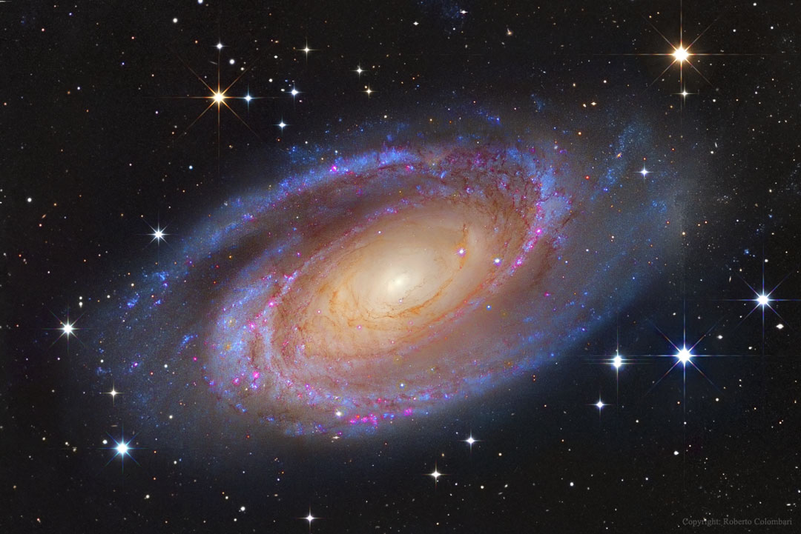
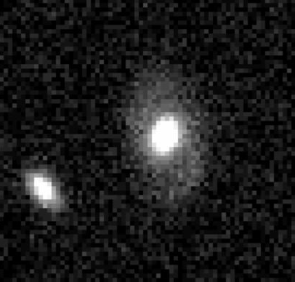
Measuring Pitch Angles
Image: M81, Ursa Major
Credit: Subaru Telescope, Hubble Space Telescope
Image: SDSS Explore
Notes:
Once I had my sample of Spiral AGN, I actually had to measure the pitch angles. This meant obtaining images off of SDSS’s webpage, and using the pre-written Matlab code Spirality. It required inner and outer radii and a file containing the image as input argument. I had to do this process for each individual galaxy. Some problems that arose: Galaxies had to be face on, and very obviously spiral structured, ie, you had to be able to tell that it was spiral. Otherwise, it would result in a large margin of error for the pitch angles.
____________
Next came the process of measuring Pitch Angles. Since GZ did not provide pitch angles with the spiral data, I had to find that myself.
To do this, I used the Matlab Function Spirality to measure the approximate pitch angle with errors.
This entailed measuring inner and outer radii of said galaxy using the program DS9.
Here’s what I expected spiral galaxies to look like: (M81 Hubble)
Hell, I would have been happy with this: (Show decent Spiral from GZ)
But I had to work with this: (Actual galaxy I had to measure)

Slide 8
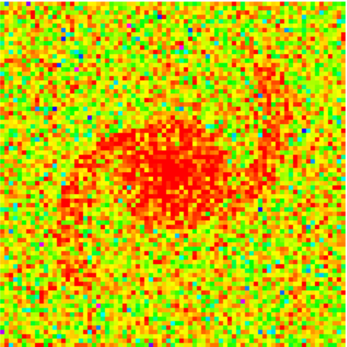
Results
Image: GenSpiral
Image: SDSS Explore
Notes:
Just to make sure Spirality was doing it right, I had to double check that the calculated pitch angle and the image were similar. See on the left the original image and on the right a simulated galaxy with similar dimensions.
_______________________________
Gen Spiral vs Photo
How inner radius vs outer radius in picture
Spectrum screenshot point to O3/Sigma/etc from DR12
Sigma is average over all fluxes in spectral lines average width over all forbidden emission lines
PA Plot

Slide 9
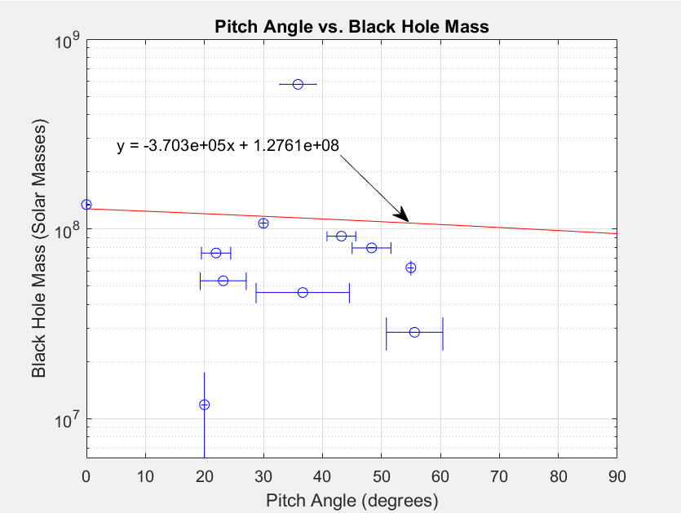
Results
Notes:
1> So we know that with larger black hole mass, we get tighter wound spiral arms. We know that the arms and the black hole are actually not correlated directly with each other, ie neither knows the other exists. Yet we see this.
2> So why? There is some indirect mechanism within the galaxy that is causing this correlation.
The leading theory at the moment is Spiral Density Wave Theory. It says that the tighter pitch angle implies that there is a higher density of gas in the disk of the galaxy. This means that there is more material that can get down into the black hole, causing it to become active. This is something that is still being researched on.
____________________________________________
Text:
What does this tell us about the coevolution?
Larger mass – more tightly wounds
Th bh and the arms are not directly correlated (they don’t actually know about eah other)
Why do we see this correlation?
What indirect mechanisms could be causing this?
-leading theory – spiral structure of disk galaxies is correlated t=with the density of
gas in the disk – the leading theory – spiral density wave theory –states that the tighter pitch angle means that there is higher density of gas in the disk
Standing waves due to differential rotation
What does it hav t do with blak hole?
-this means that there is more material that can potentially get down to the black hole
-both are correlated with the density of gas in the disk. Indirect correlation
Conclusions – does it compare to the non-AGN plot? How so?

Slide 10
Conclusions
What does this tell us about the coevolution of black holes with their hosts?
What indirect mechanisms are causing this?
Notes:
1> So we know that with larger black hole mass, we get tighter wound spiral arms. We know that the arms and the black hole are actually not correlated directly with each other, ie neither knows the other exists. Yet we see this.
2> So why? There is some indirect mechanism within the galaxy that is causing this correlation.
The leading theory at the moment is Spiral Density Wave Theory. It says that the tighter pitch angle implies that there is a higher density of gas in the disk of the galaxy. This means that there is more material that can get down into the black hole, causing it to become active. This is something that is still being researched on.
____________________________________________
Text:
What does this tell us about the coevolution?
Larger mass – more tightly wounds
Th bh and the arms are not directly correlated (they don’t actually know about eah other)
Why do we see this correlation?
What indirect mechanisms could be causing this?
-leading theory – spiral structure of disk galaxies is correlated t=with the density of
gas in the disk – the leading theory – spiral density wave theory –states that the tighter pitch angle means that there is higher density of gas in the disk
Standing waves due to differential rotation
What does it hav t do with blak hole?
-this means that there is more material that can potentially get down to the black hole
-both are correlated with the density of gas in the disk. Indirect correlation
Conclusions – does it compare to the non-AGN plot? How so?

Slide 11
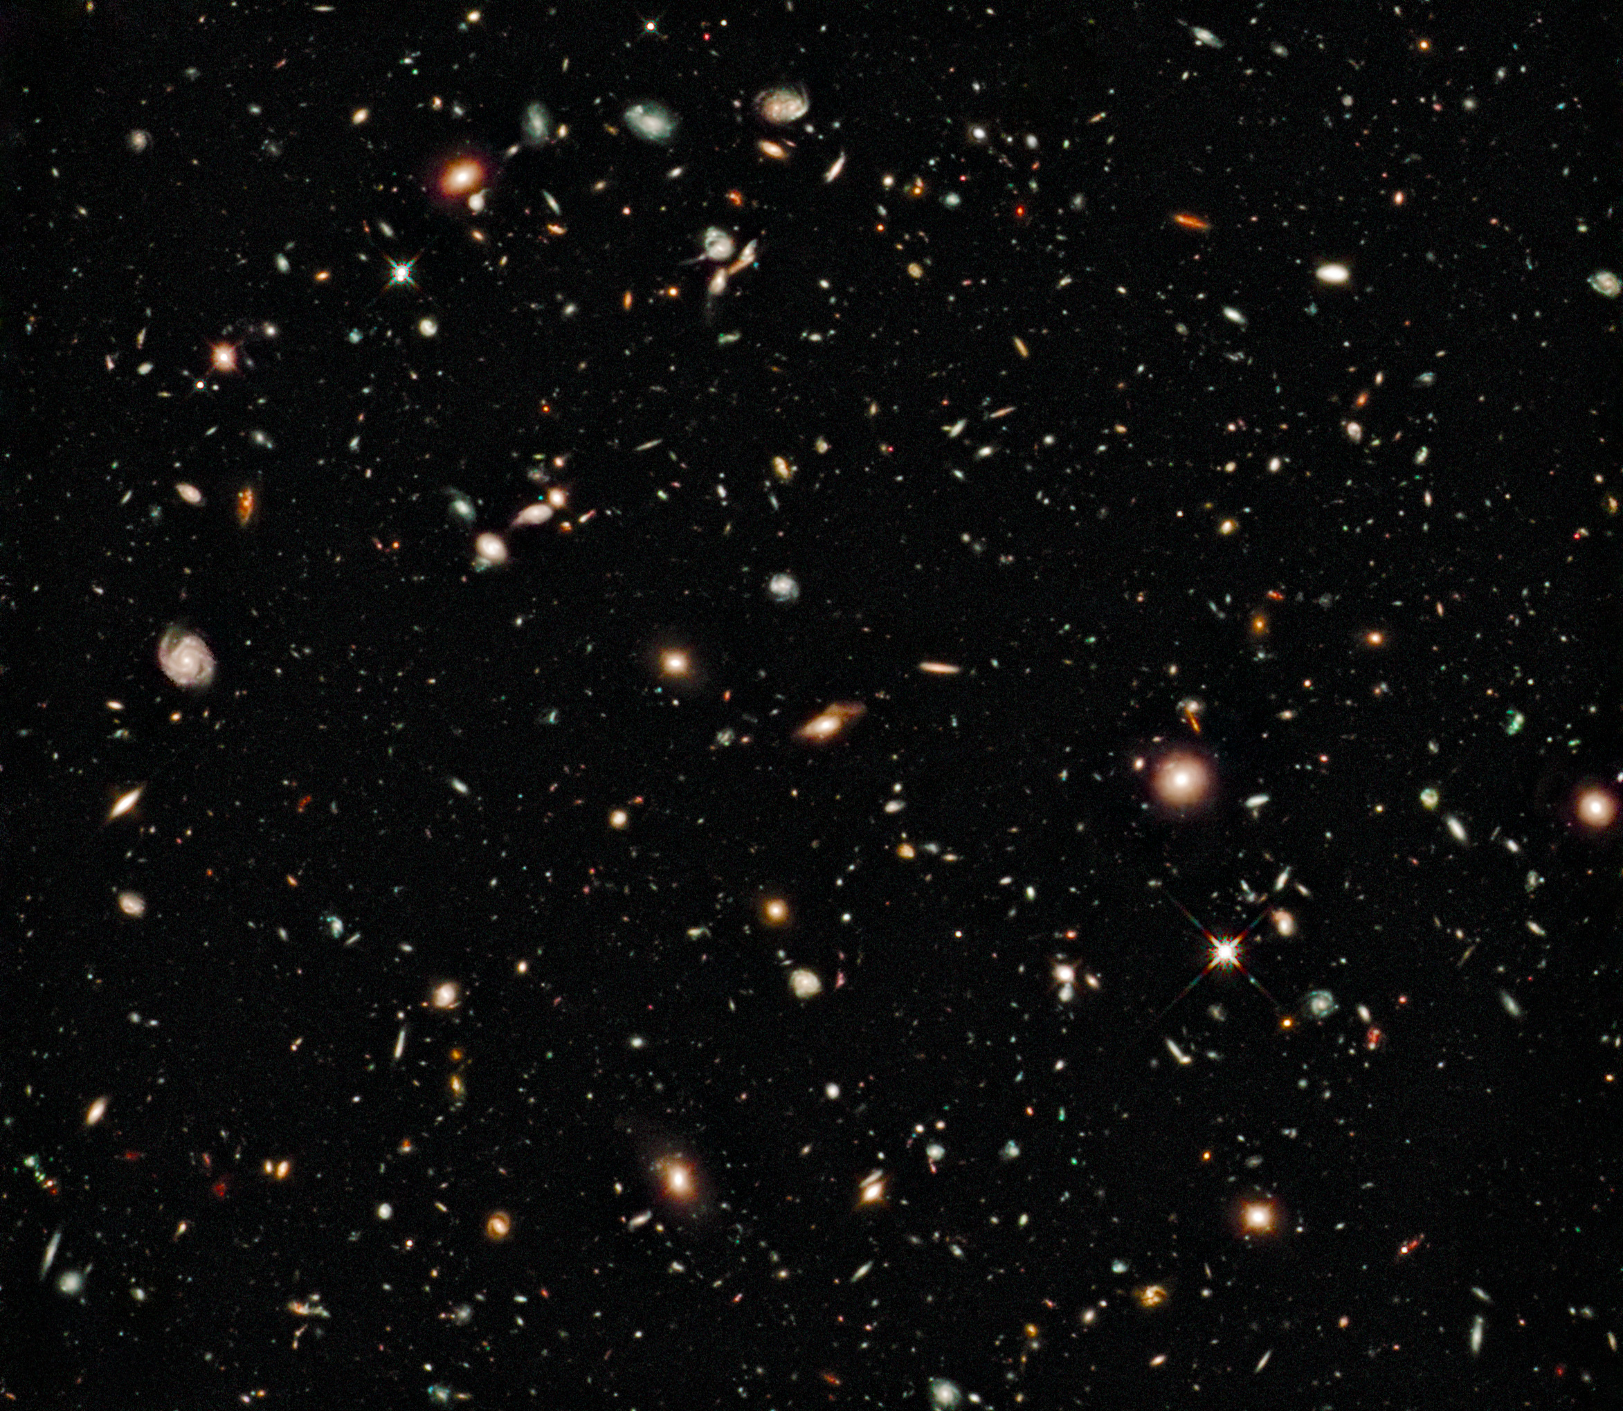
What’s next?
Edge-On PA’s vs Bulge Mass
Later Data Releases from Sloan
Hubble Deep Field Data
Image: Hubble Ultra Deep Field
Credit: Hubble/ESA
Notes:
Describe what I plan to do next with research, including getting PA.s from edge-on galaxies, deep field data and later DR’s (and whatever Scott has planned for this project)

Slide 12
Acknowledgements
Dr. R. Scott Barrows, my mentor
Dr. Nadine Barlow and Kathleen Stigmon and the NASA Space Grant Consortium
Dr. William (Buzz) Delinger, and Heather Charles, the local MATLAB experts
Notes:
Also now is time to take any question

